Slide 1
Machine learning .Net
https://learn.microsoft.com/en-us/dotnet/machine-learning

Slide 2
What is ML.Net?
Open-source, cross-platform machine learning framework for .NET

Slide 3
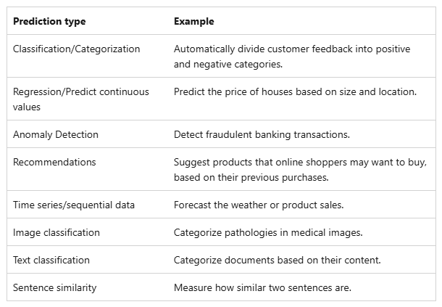
Scenario - Machine learning task mapping

Slide 4
Hello ML world
What is ML.NET and how does it work? - ML.NET | Microsoft Learn

Slide 5
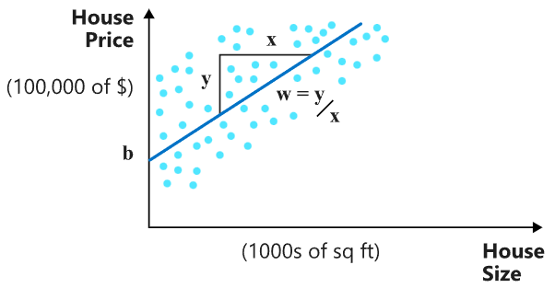

Linear regression - House price prediction

Slide 6
Some basic terms
Training data: The data used to find the parameters of the model
Features: The inputs of a machine learning model are called.
Labels: The ground-truth values used to train a machine learning model

Slide 7
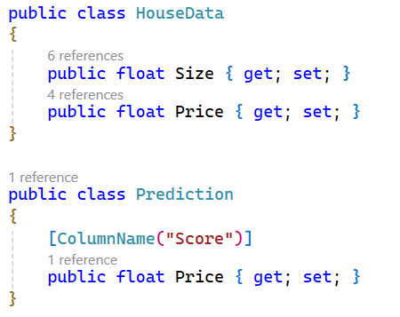
Model preparation

Slide 8
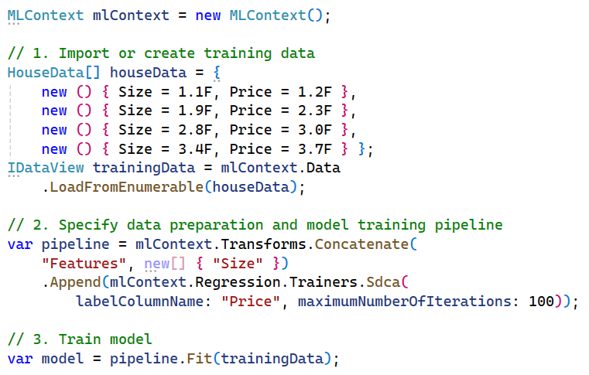
2. Prepare data & train

Slide 9
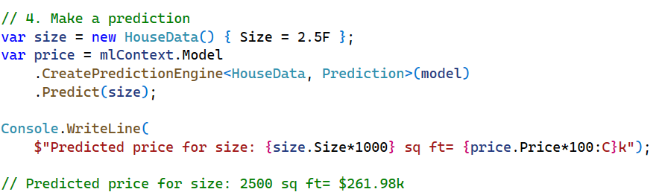
3. Make prediction

Slide 10
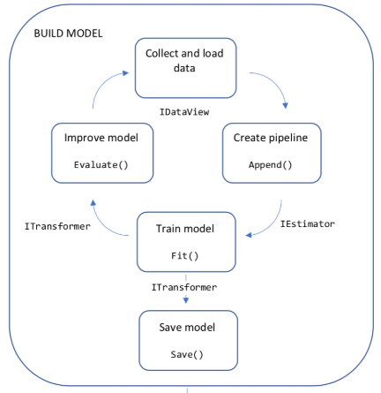
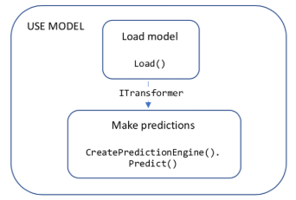
Workflow

Slide 11
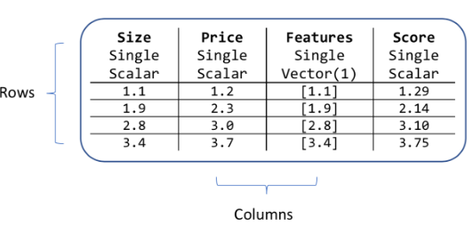
Data models & schema
DataView

Slide 12
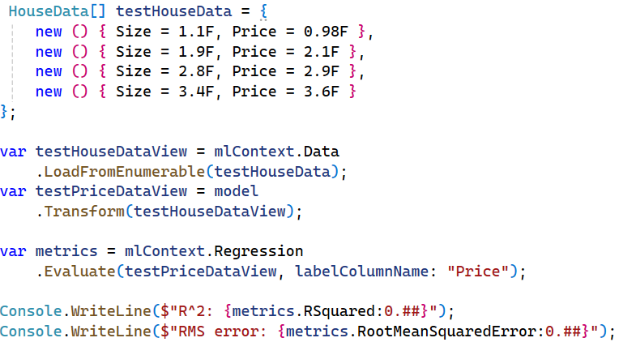
4. Model evaluation using test data

Slide 13
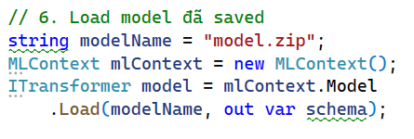
5. Model deployment

Slide 14
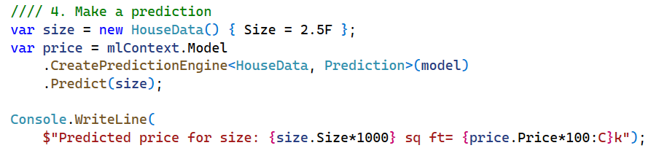
6. Make prediction after loading model

Slide 15
Model Builder
ML.NET Tutorial | Get started in 10 minutes | .NET

Slide 16
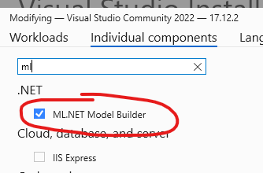
Installation

Slide 17

2. Create a C# console app

Slide 18
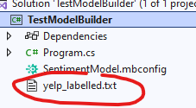
3. Download data
Dataset: Sentiment Labelled Sentences
Author: UCI Machine Learning Repository
Uncompress, add file yelp_labelled.txt to your project

Slide 19
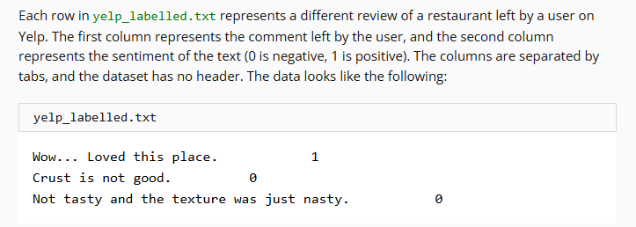
Data exploration

Slide 20
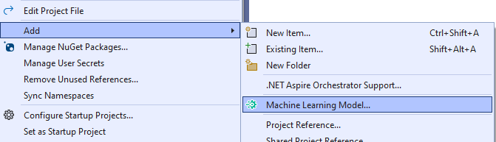
4. Add machine learning
Right click on the project
Add > Machine learning model…

Slide 21
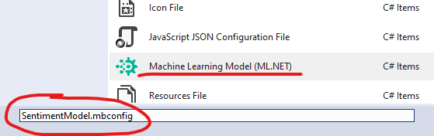
5. Name your model: SentimentModel

Slide 22
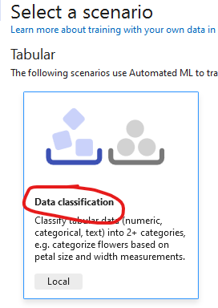
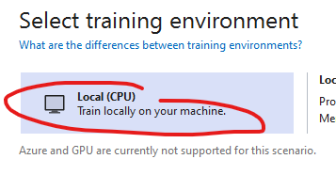
6. Config your training

Slide 23
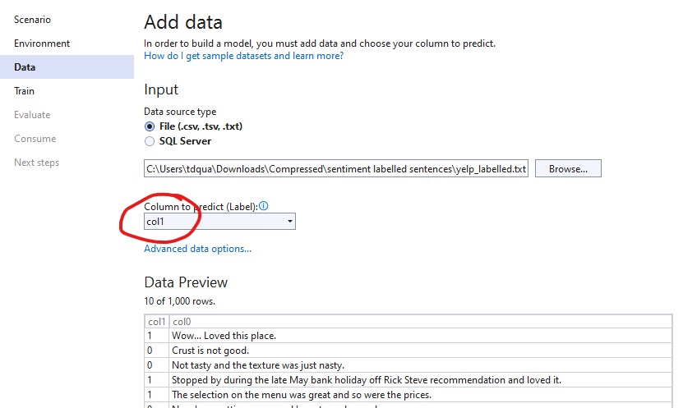
7. Add data

Slide 24
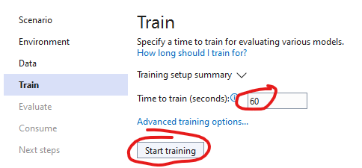
8. Train your model

Slide 25
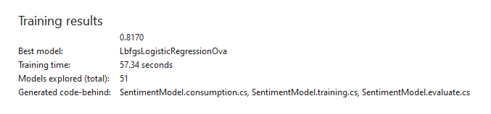
9. Training result

Slide 26
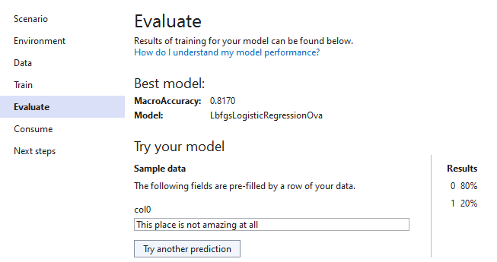
10. Evaluate the model

Slide 27
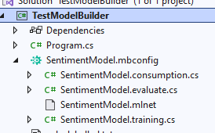
11. Auto generated code
SentimentModel.consumption.cs: model input & output classes & a Predict method that can be used for model consumption.
SentimentModel.evaluate.cs: CalculatePFI method that uses the Permutation Feature Importance (PFI) technique to evaluate which features contribute most to the model predictions
SentimentModel.mlnet: This file is the trained ML.NET model, which is a serialized zip file.
SentimentModel.training.cs: code to understand the importance input columns have on your model predictions

Slide 28
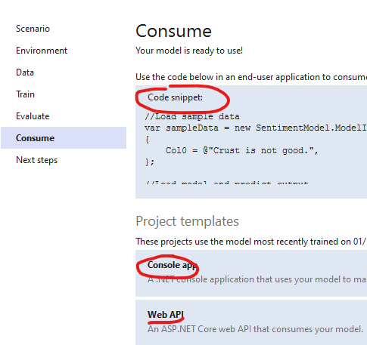
12. Consume your model

Slide 29
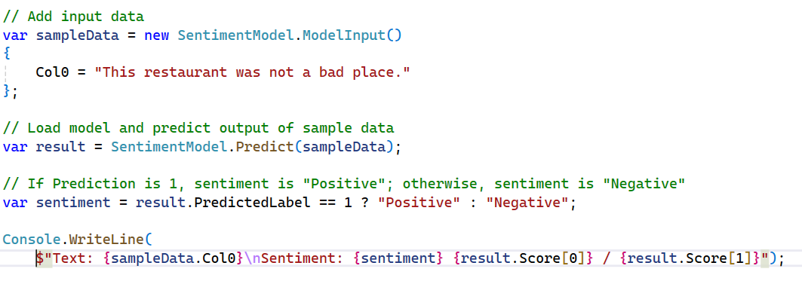
Testing with generated code snippet

Slide 30
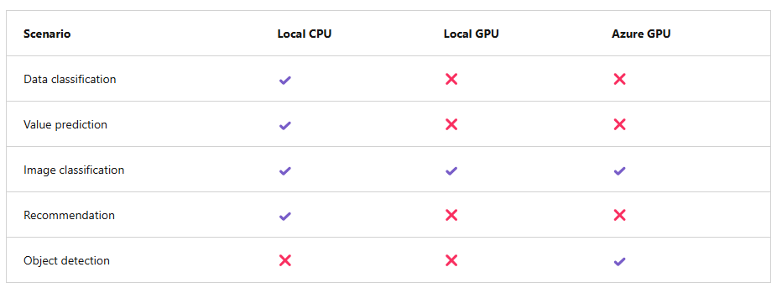
Supported environments in Model Builder

Slide 31
Types of problem to use with Model Builder
Categorizing data: Organize news articles by topic.
Predicting a numerical value: Estimate the price of a home.
Grouping items with similar characteristics: Segment customers.
Recommending items: Recommend movies.
Classifying images: Tag an image based on its contents.
Detecting objects in an image: Detect pedestrians and bicycles at an intersection

Slide 32
Train a predictive maintenance model
Train a machine learning model for predictive maintenance by using ML.NET Model Builder - Training | Microsoft Learn

Slide 33
Prepare dataset
AI4I 2020 Predictive Maintenance
10,000 data points and 14 columns.

Slide 34
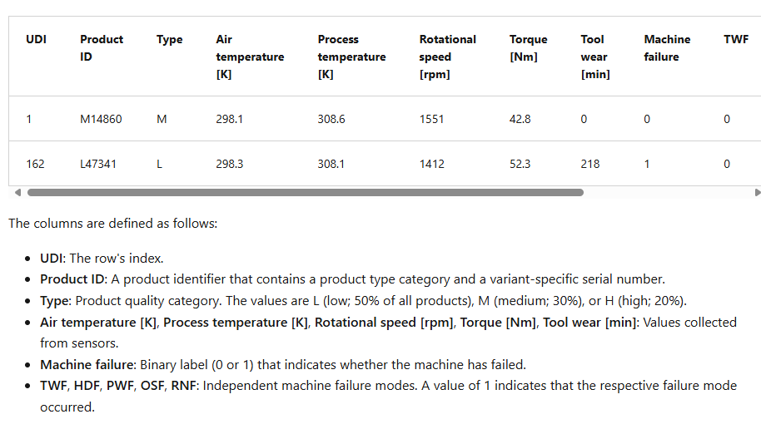
Data understanding

Slide 35
Data analysis
Not all the columns in the dataset are needed
Because you want to be able to predict whether a machine will fail or not, the Machine failure column is the label. In Model Builder, for features, you can use data from the Product ID, Type, and various sensor columns.
Although the failure modes are useful in diagnosing the root cause of a failure, they aren't useful for your use case.

Slide 36
2. Add ML Model to a new project
PredictiveMaintenanceModel
Remove special characters in dataOriginal header:
UDI,Product ID,Type,Air temperature [K],Process temperature [K],Rotational speed [rpm],Torque [Nm],Tool wear [min],Machine failure,TWF,HDF,PWF,OSF,RNF
Updated header:
UDI,Product ID,Type,Air temperature,Process temperature,Rotational speed,Torque,Tool wear,Machine failure,TWF,HDF,PWF,OSF,RNF

Slide 37
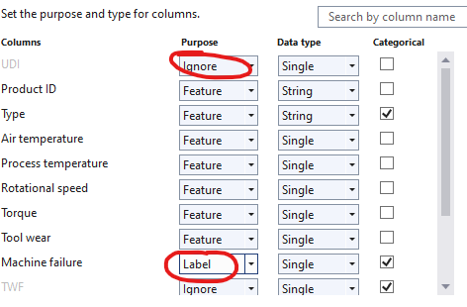
3. Column settings

Slide 38
4. Train
Time: 30s

Slide 39
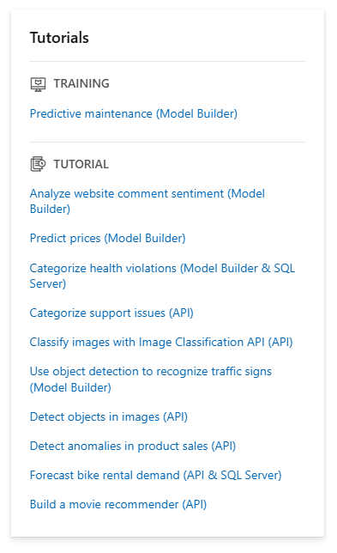
What’s next?
https://learn.microsoft.com/en-us/dotnet/machine-learning

